Slide 1
Why Python?
Luís A. Nunes Amaral

Slide 2
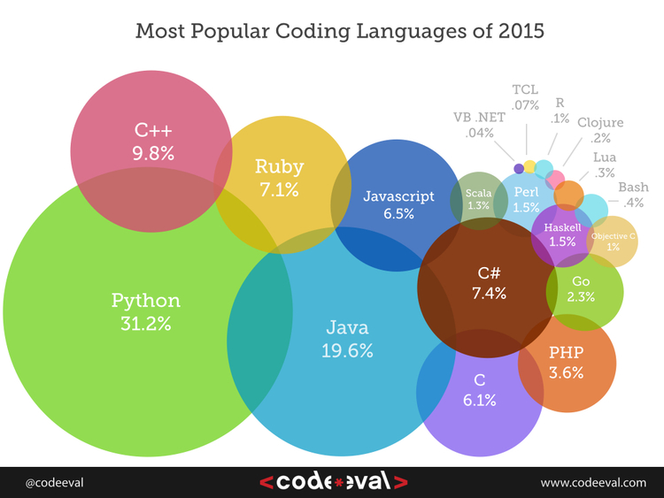
Employer needs
Results based on hundreds of thousands of data points collected by processing 600,000+ coding tests and challenges by 2,000+ employers.

Slide 3
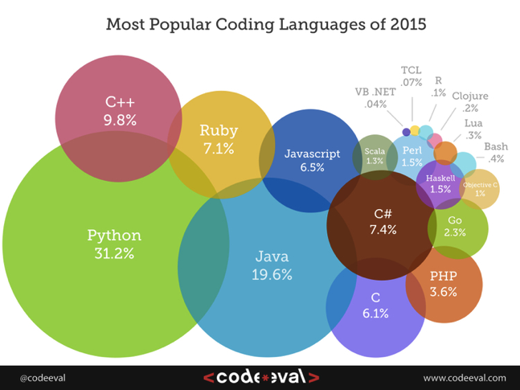
Employer needs
Growing:
C
C#
Javascript
Python
Shrinking:
C++ (20%)
Java (17%)
Perl
Ruby (28%)
Python top-ranked language fourth year in a row!

Slide 4
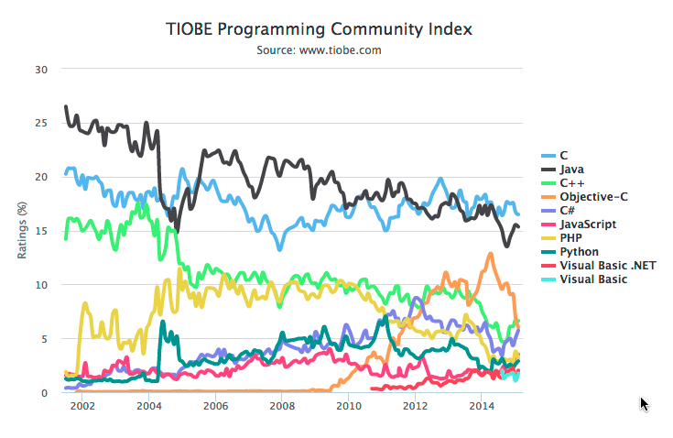
Search engine popularity
The TIOBE Programming Community index is an indicator of the popularity of programming languages

Slide 5
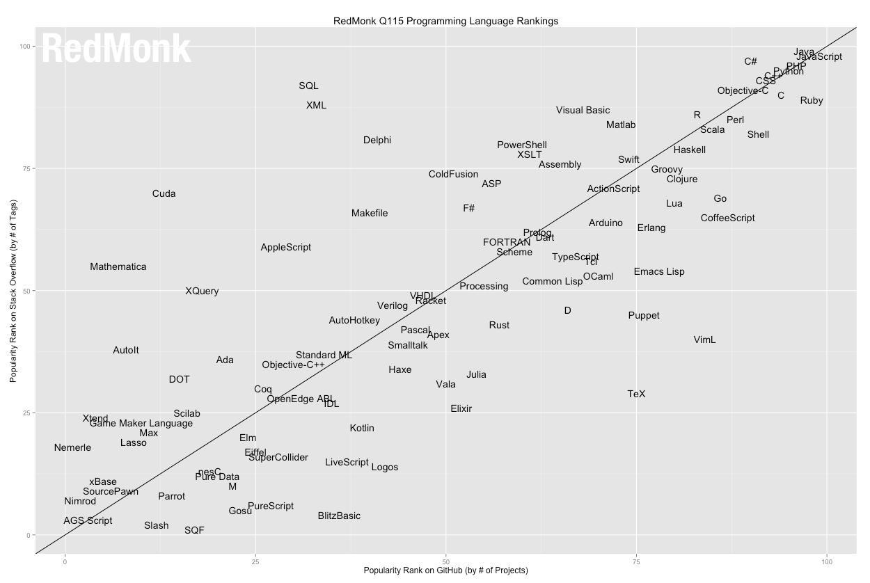
Developer activity
1. JavaScript
2. Java
3. PHP
4. Python
5. C#
5. C++
5. Ruby
8. CSS
9. C
10. Obj-C
11. Perl
11. Shell
13. R
14. Scala
15. Haskell
16. Matlab
17. Vis. Basic
StackOverflow
GitHub

Slide 6
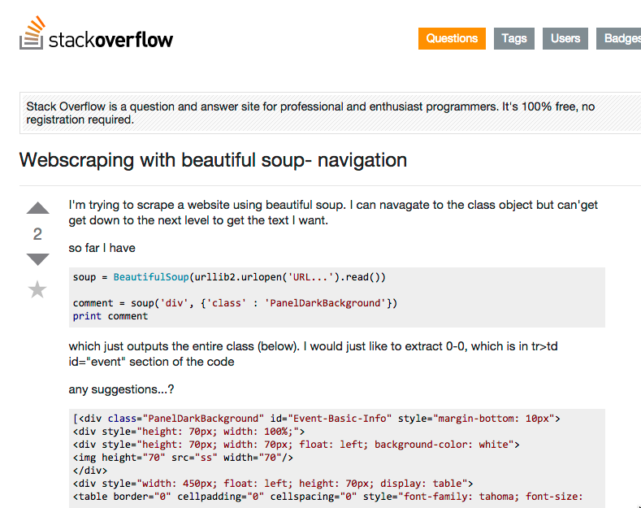
We all need help

Slide 7
Code is more often read than written
http://docs.python-guide.org/en/latest/writing/style/

Slide 8
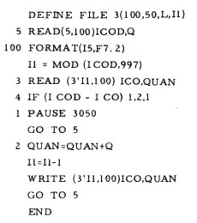
Code is more often read than written

Slide 9
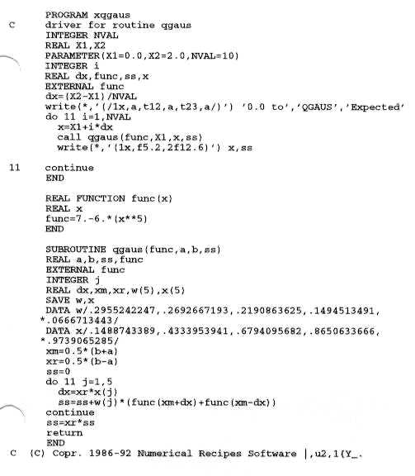
Code is more often read than written

Slide 10
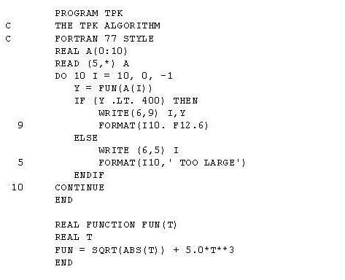
Code is more often read than written

Slide 11
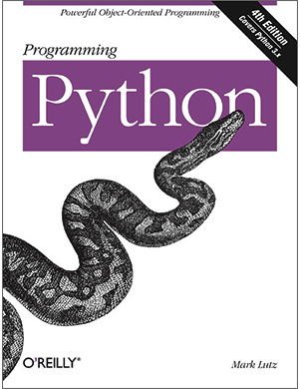
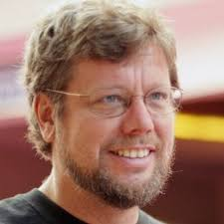
Python
Guido van Rossum
Language was named after Monty Python’s Flying Circus

Slide 12
A high level of readability is at the heart of the design of the Python language
http://docs.python-guide.org/en/latest/writing/style/

Slide 13
One reason for Python code to be easily read and understood is its relatively complete set of Code Style guidelines and “Pythonic” idioms.

Slide 14
Perl vs. Python
Perl: "There's more than one way to do it.”
(also: "There's more ways to do it than you can remember, probably more than you can even recognize.”)
Python: "There should be one -- and preferably only one -- obvious way to do it.”

Slide 15
Perl vs. Python
Perl: ”Look how smart I am.”
Python: ”If you can understand what I did, we can make something better.”

Slide 16
Language strengths
C: Simple, fast and flexible. Makes for smaller programs. (1989)
C++: Great for large complex projects because it is object-oriented. (1998)
FORTRAN: Very fast. Perfect for number crunching. (1966)
Javascript: Website development. (1997)

Slide 17
Language strengths
Java: Multiplatform, portable. Similar to C++.
Mathematica: Symbolic calculations.
Matlab: Domain specific number crunching.
PHP: Scripting language for website development.
Python: Multi-purpose language. Highly-readable. Extremely flexible.

Slide 18
A high level of readability is at the heart of the design of the Python language
http://docs.python-guide.org/en/latest/writing/style/

Slide 19
The Zen of Python
Beautiful is better than ugly.
Explicit is better than implicit.
Simple is better than complex.
Complex is better than complicated.
Flat is better than nested.
Sparse is better than dense.
Readability counts.
Special cases aren't special enough to break the rules.
Although practicality beats purity.
Errors should never pass silently.
Unless explicitly silenced.

Slide 20
The Zen of Python
In the face of ambiguity, refuse the temptation to guess.
There should be one-- and preferably only one --obvious way to do it.
Although that way may not be obvious at first unless you're Dutch.
Now is better than never.
Although never is often better than *right* now.
If the implementation is hard to explain, it's a bad idea.
If the implementation is easy to explain, it may be a good idea.
Namespaces are one honking great idea -- let's do more of those!
https://www.python.org/dev/peps/pep-0020/
http://programmers.stackexchange.com/questions/148790/is-the-14th-line-of-the-zen-of-python-a-reference-to-dijkstra

Slide 21
Python is extremely flexible

Slide 22
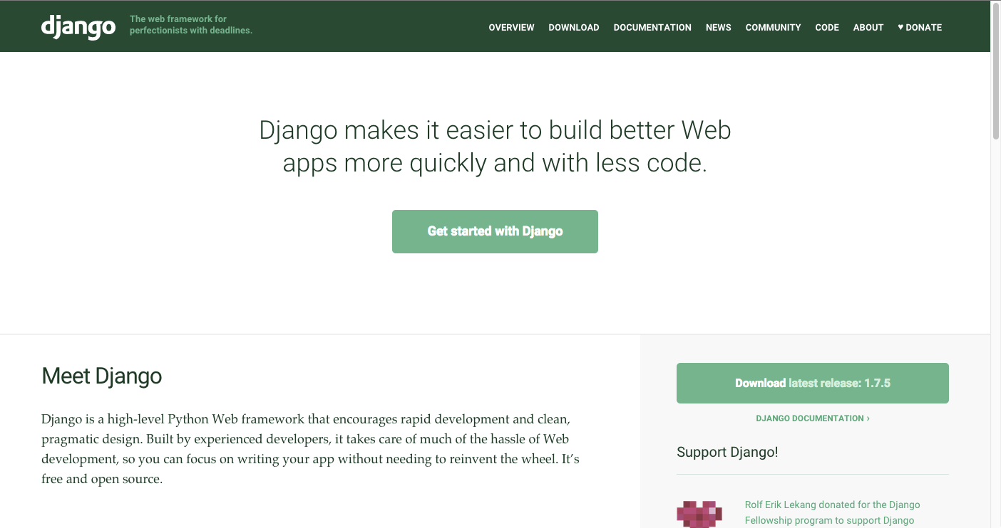
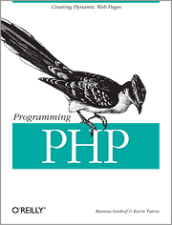
Web development

Slide 23
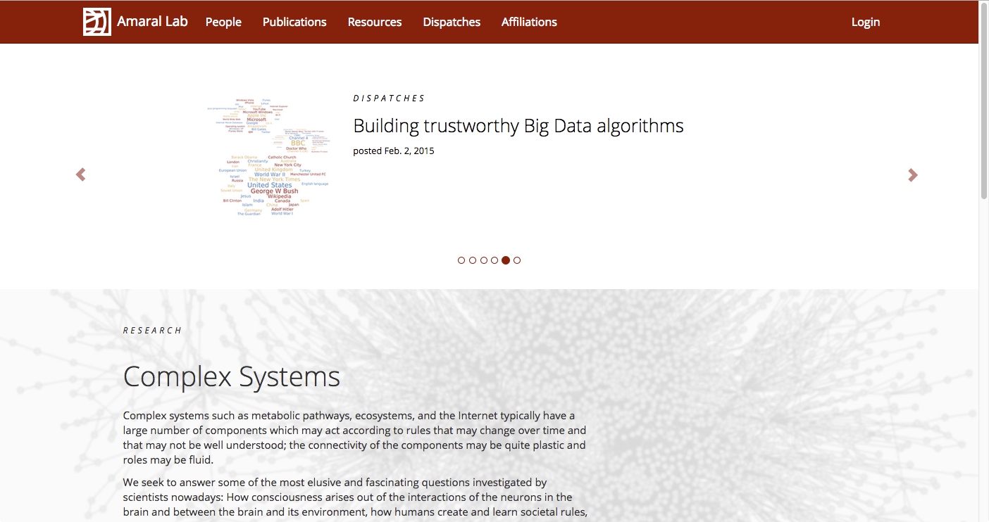
Web development

Slide 24
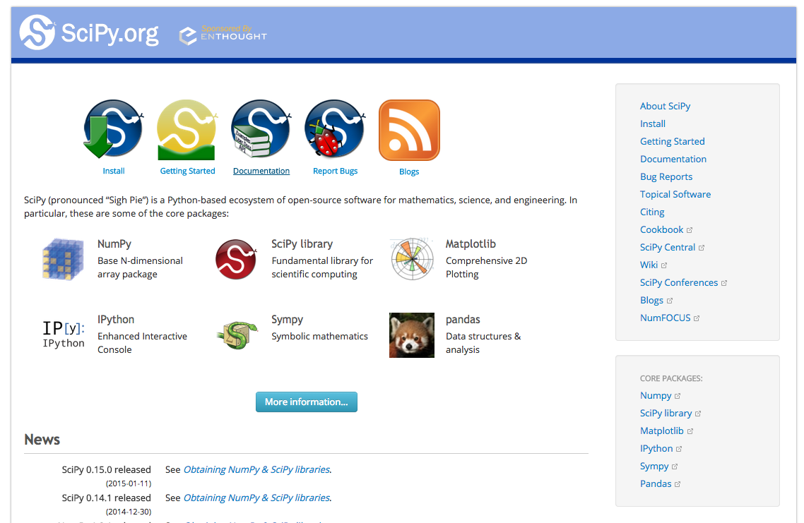

Scientific computing

Slide 25
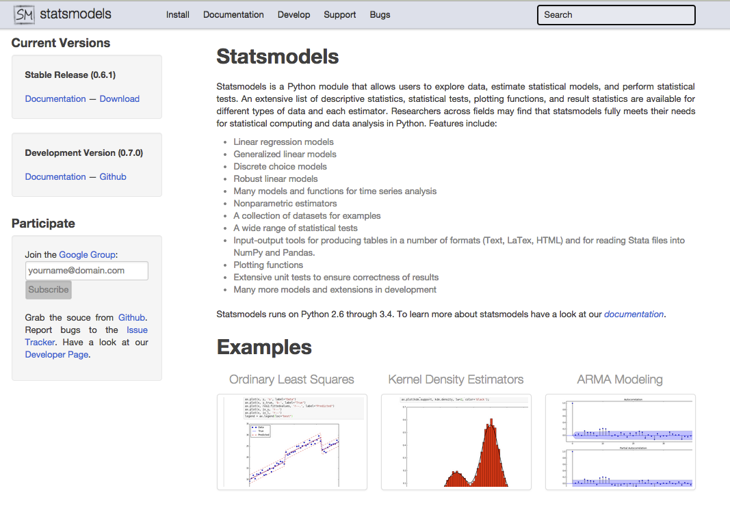
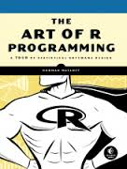
Statistical analysis

Slide 26
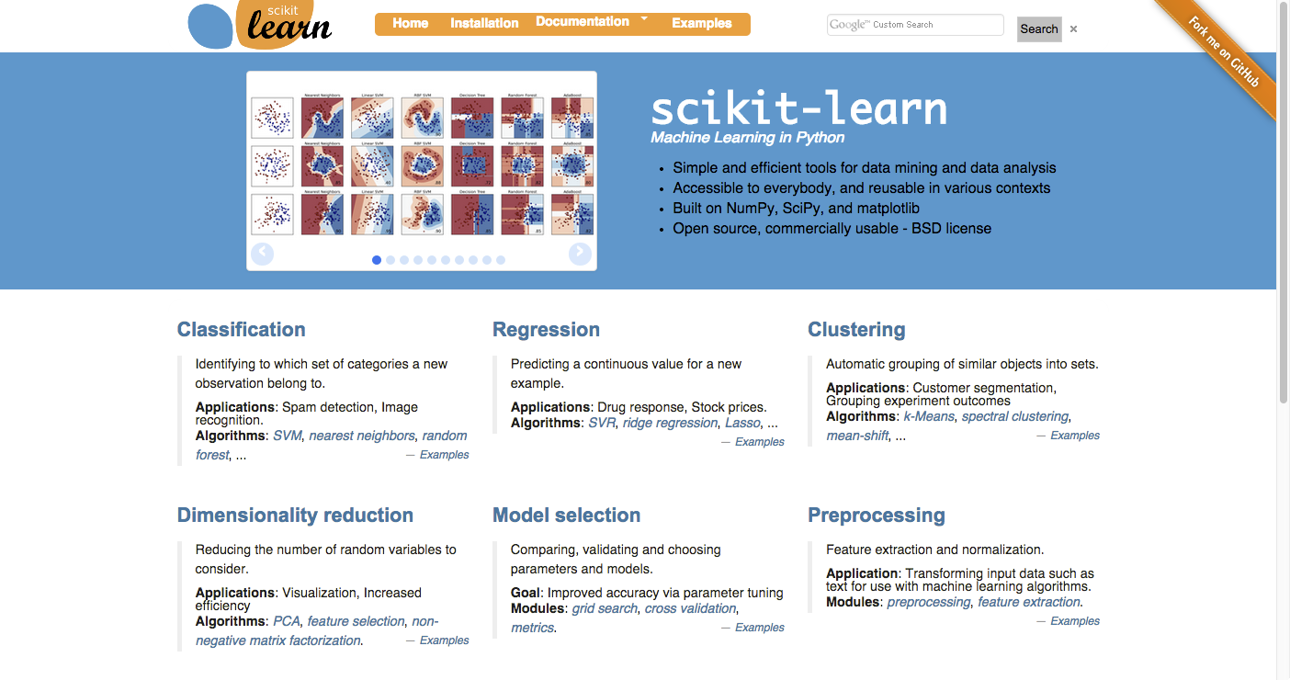
Machine learning

Slide 27
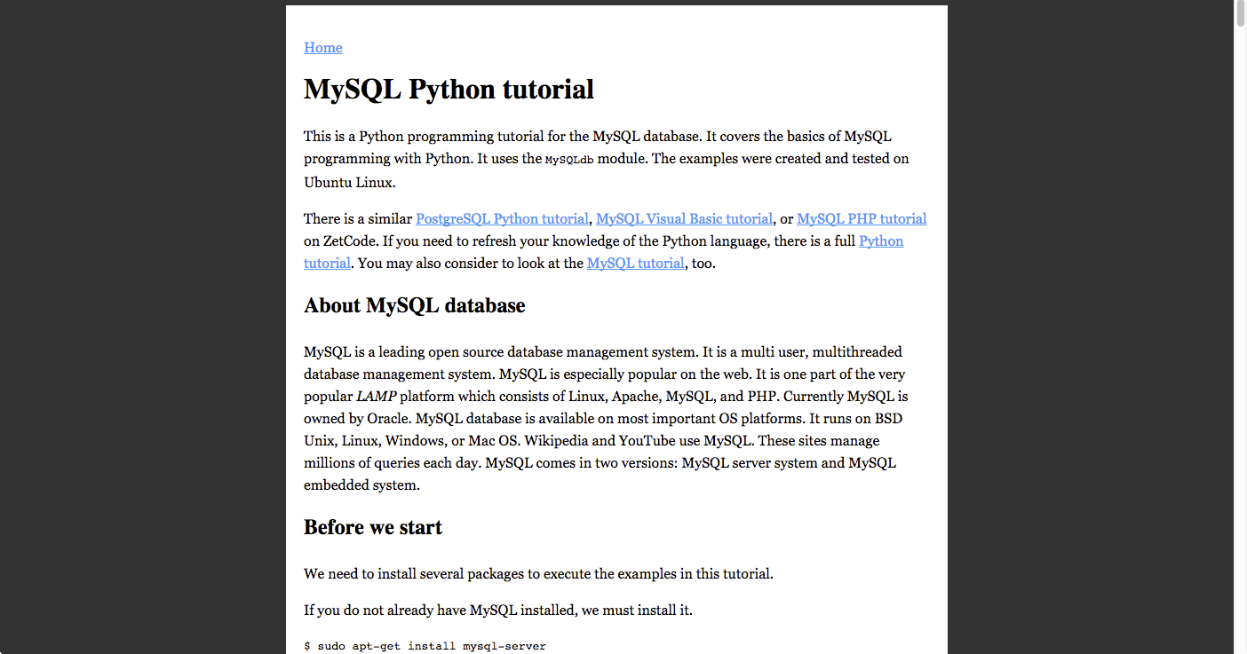
Database interaction

Slide 28
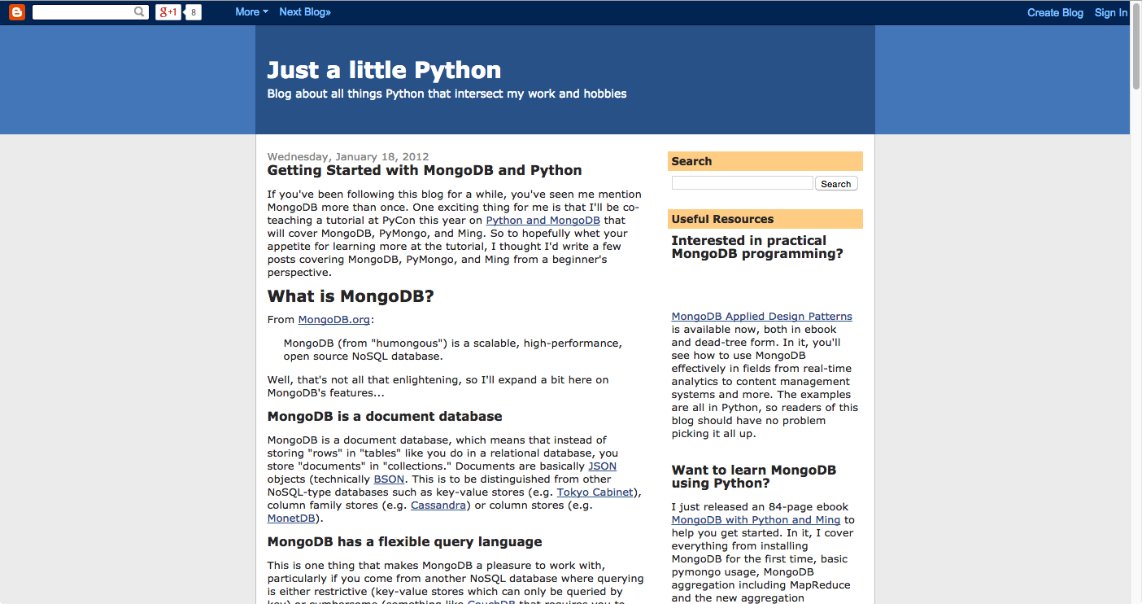
Database interaction

Slide 29
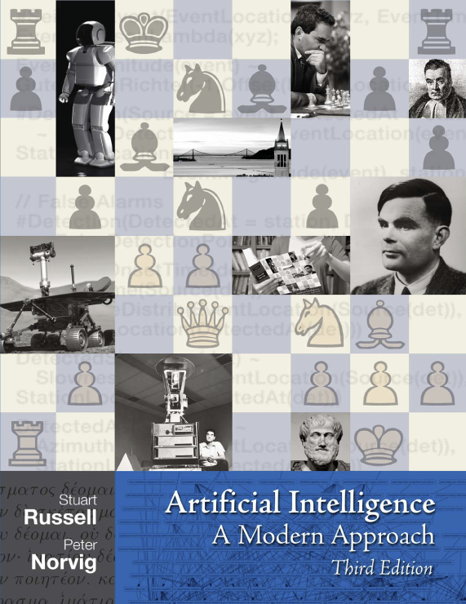
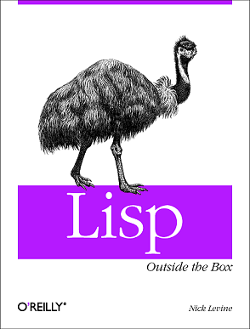
Artificial intelligence

